Slide 1

Angular Concepts
[Phong Ha]

Slide 2
Content
What is Angular
Modules
Components
Services and DI
Routing
Hook

Slide 3
What is Angular
Angular is a platform and framework for building single-page client applications using HTML and TypeScript. Angular is written in TypeScript. It implements core and optional functionality as a set of TypeScript libraries that you import into your apps.
Angular is a client-side JavaScript framework that was specifically designed to help developers build SPAs (Single Page Applications) in accordance with best practices for web development. By providing a structured environment for building SPAs, the risk of producing “spaghetti code” is highly reduced.

Slide 4
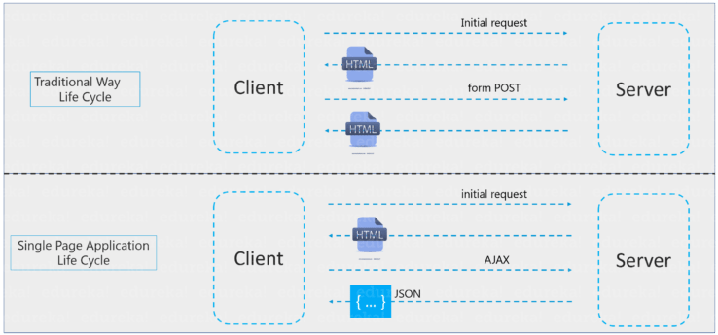
Single-Page Applications
Single-Page Applications (or SPA’s) are applications that are accessed via a web browser like other websites but offer more dynamic interactions resembling native mobile and desktop apps. The most notable difference between a regular website and SPA is the reduced amount of page refreshes. SPAs have a heavier usage of AJAX- a way to communicate with back-end servers without doing a full page refresh to get data loaded into our application. As a result, the process of rendering pages happens mostly on the client-side.

Slide 5
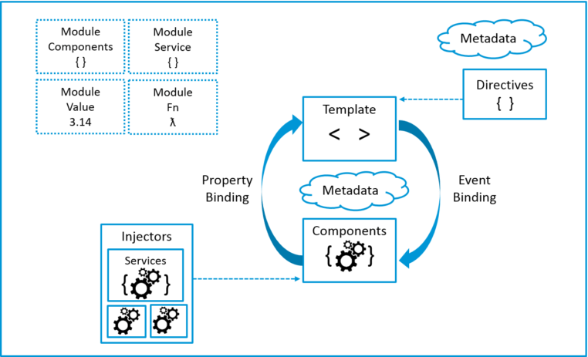
Architecture

Slide 6
Introduction to modules
Angular apps are modular and to maintain modularity, we have Angular modules or you can say NgModules. Every Angular app contains at least one Angular module, i.e. the root module. Generally, it is named as AppModule. The root module can be the only module in a small application. While most of the apps have multiple modules. You can say, a module is a cohesive block of code with a related set of capabilities that have a specific application domain or a workflow. Any angular module is a class with @NgModule decorator.

Slide 7
NgModule metadata
Decorators are functions that modify JavaScript classes. Decorators are basically used for attaching metadata to classes so that, it knows the configuration of those classes and how they should work. NgModule is a decorator function that takes metadata objects whose properties describe the module. The properties are:
declarations: The classes that are related to views and they belong to this module. There are three classes of Angular that can contain view: components, directives, and pipes.
exports: The subset of declarations that should be visible and usable in the component templates of other NgModules.
imports: Other modules whose exported classes are needed by component templates declared in this NgModule.
providers: Creators of services that this NgModule contributes to the global collection of services; they become accessible in all parts of the app. (You can also specify providers at the component level.)
bootstrap: The main application view, called the root component, which hosts all other app views. Only the root NgModule should set the bootstrap property.

Slide 8
Introduction to components and templates
A component controls a patch of screen called a view. For example, individual components define and control each of the following views from the Tour of Heroes tutorial:
The app root with the navigation links.
The list of heroes.
The hero editor.
You define a component's application logic—what it does to support the view—inside a class. The class interacts with the view through an API of properties and methods.

Slide 9
Component metadata
The @Component decorator identifies the class immediately below it as a component class, and specifies its metadata. In the example code below, you can see that HeroListComponent is just a class, with no special Angular notation or syntax at all. It's not a component until you mark it as one with the @Component decorator.
The metadata for a component tells Angular where to get the major building blocks that it needs to create and present the component and its view. In particular, it associates a template with the component, either directly with inline code, or by reference. Together, the component and its template describe a view.
In addition to containing or pointing to the template, the @Component metadata configures, for example, how the component can be referenced in HTML and what services it requires.

Slide 10
Component metadata
This example shows some of the most useful @Component configuration options:
selector: A CSS selector that tells Angular to create and insert an instance of this component wherever it finds the corresponding tag in template HTML. For example, if an app's HTML contains <app-hero-list></app-hero-list>, then Angular inserts an instance of the HeroListComponent view between those tags.
templateUrl: The module-relative address of this component's HTML template. Alternatively, you can provide the HTML template inline, as the value of the template property. This template defines the component's host view.
providers: An array of providers for services that the component requires. In the example, this tells Angular how to provide the HeroService instance that the component's constructor uses to get the list of heroes to display.

Slide 11
Template syntax
A template looks like regular HTML, except that it also contains Angular template syntax, which alters the HTML based on your app's logic and the state of app and DOM data. Your template can use data binding to coordinate the app and DOM data, pipes to transform data before it is displayed, and directives to apply app logic to what gets displayed.

Slide 12
Template syntax
A template looks like regular HTML, except that it also contains Angular template syntax, which alters the HTML based on your app's logic and the state of app and DOM data. Your template can use data binding to coordinate the app and DOM data, pipes to transform data before it is displayed, and directives to apply app logic to what gets displayed.

Slide 13
Template syntax
This template uses typical HTML elements like <h2> and <p>, and also includes Angular template-syntax elements, *ngFor, {{hero.name}}, (click), [hero], and <app-hero-detail>. The template-syntax elements tell Angular how to render the HTML to the screen, using program logic and data.
The *ngFor directive tells Angular to iterate over a list.
{{hero.name}}, (click), and [hero] bind program data to and from the DOM, responding to user input. See more about data binding below.
The <app-hero-detail> tag in the example is an element that represents a new component, HeroDetailComponent. HeroDetailComponent (code not shown) defines the hero-detail child view of HeroListComponent. Notice how custom components like this mix seamlessly with native HTML in the same layouts.

Slide 14
Data binding
Angular supports two-way data binding, a mechanism for coordinating the parts of a template with the parts of a component. Add binding markup to the template HTML to tell Angular how to connect both sides.
The following diagram shows the four forms of data binding markup. Each form has a direction: to the DOM, from the DOM, or both.

Slide 16

Thank You!

